Slide 1




Lesson 4: Python Web Scraping
Haihua Chen, Ph.D.
9402200057
Haihua.chen@unt.edu

Slide 2

Agenda
1
Intro to Web Scraping
2
Ways to collect text data
3
Tools for Web Scraping

Slide 3
1
Intro to Web Scraping

Slide 4
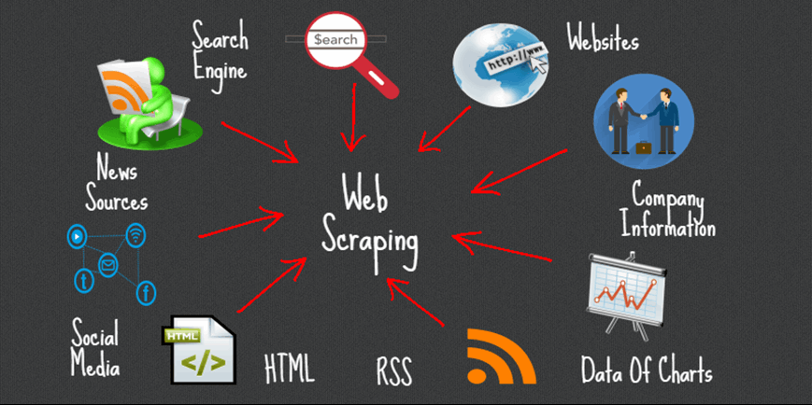


Web Scraping
Web scraping is a computer software technique of extracting information from websites.

Slide 5
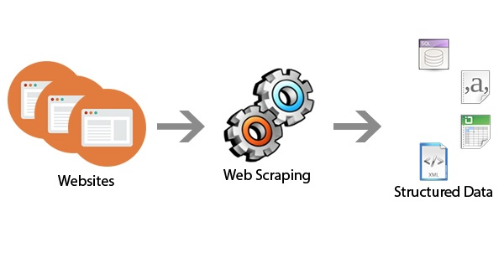
Web Scraping
Transform unstructured data (HTML format) on the web into structured data (database or spreadsheet).
Notes:
What is the difference between structured and unstructured data?
Structured data is highly-organized and formatted in a way so it's easily searchable in relational databases. Unstructured data has no pre-defined format or organization, making it much more difficult to collect, process, and analyze.
https://forecast.weather.gov/MapClick.php?textField1=33.22&textField2=-97.15#.YBmVKej0mbh

Slide 6
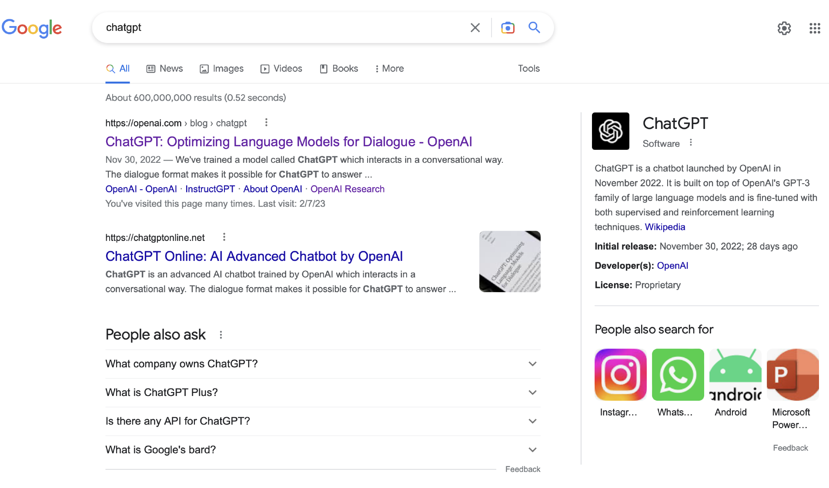
Why Web Scraping?
Q: How does a search engine know that all these pages contain the query terms?
A: Because all of those pages have been crawled

Slide 7
Why Web Scraping?
What should we search?
Every document on the web answers at least one question.
Every time a search engine adds another document, the number of questions it can answer increases
Adding many poor-quality documents increases the burden on the ranking process to find only the best documents to show to the user
Web crawling discuss strategies for storing documents and keeping those documents up-to-date!!!

Slide 8
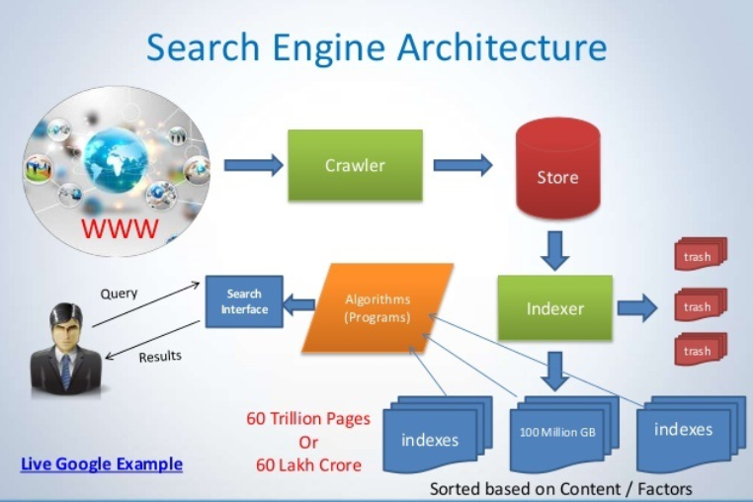
Why Web Scraping?

Slide 9
Why Web Scraping? Search Engine Architecture
Architecture of a search engine determined by 2 requirements
effectiveness (quality of results) and efficiency (response time and throughput)
Important components of search engine are:
Web Crawler: This component is used to find information on hundreds of millions of webpages that exists
Indexer: This component is used to categorize and filter the pages based on content.
Query processer: This component is used to translate high-level queries into low-level expressions that can be used at the physical level of the file system, query optimization and actual execution of the query to get the result.
Algorithms: IR models to match the query and the documents
Search Interface : The interface with which the user can access the search engine.
Some Popular Search Engines
Google
Bing
Yahoo
Baidu

Slide 10
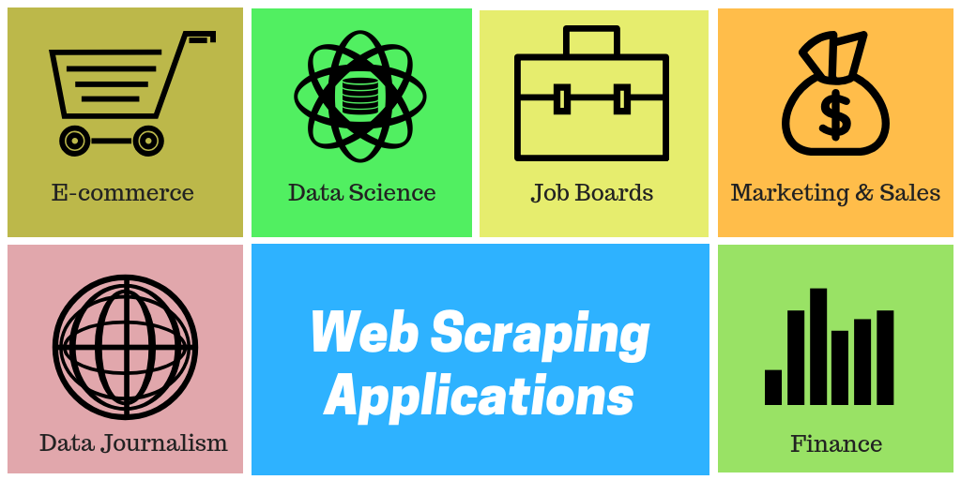
Why Web Scraping?
We need to extract data from the web to conduct data mining and build a machine learning model

Slide 11
Web Scraping Applications
Web Scraping Applications in Retail and Manufacturing
Web Scraping Applications in Equity and Financial Research
Web Scraping Applications in Data Science
Web Scraping Applications in Risk Management
Web Scraping Applications in Product, Marketing and Sales
Others: News and Reputation Monitoring, Academic, Employment, etc.
Notes:
https://towardsdatascience.com/https-medium-com-hiren787-patel-web-scraping-applications-a6f370d316f4

Slide 12
How to collect text data?
Manually
Business tools such as import.io (https://www.import.io/)
Web Scraping
Others?
NLTK

Slide 13
2
Python Web Scraping

Slide 14
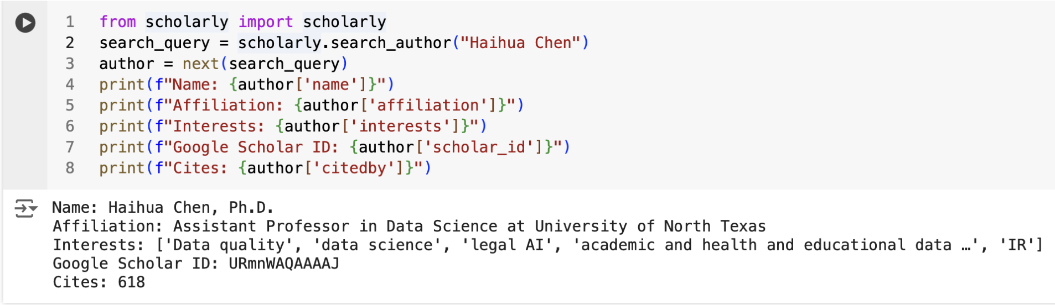
Several ways to collect text data by Python-API
API (Application programming interface) is the best way to extract data from a website.
Notes:
https://pypi.org/project/scholarly/

Slide 15
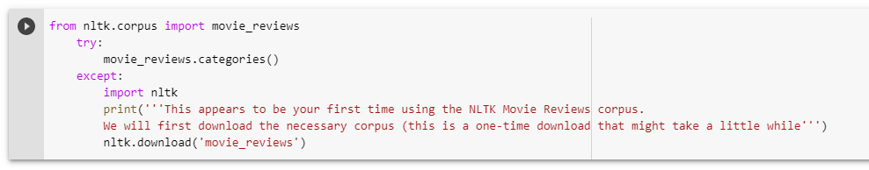
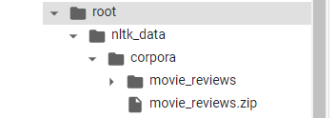
Several ways to collect text data by Python-NLTK
NLTK includes a diverse set of corpora which can be read using the nltk.corpus package.
Notes:
http://www.nltk.org/howto/corpus.html

Slide 16
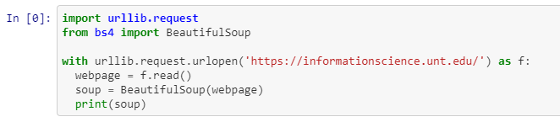
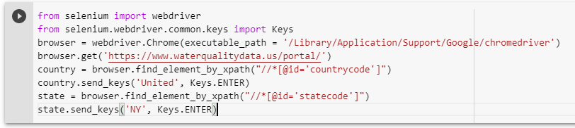
Several ways to collect text data by Python-Web Scraping
Beautiful Soup
Scrapy
Selenium
Pyspider

Slide 17
Comparison of the four tools
 | Advantages | Disadvantages
Beautiful Soup | Easy to learn and master Good comprehensive documentation Active Community | urllib.request is needed to make a request to the website Require an External parser to parse the downloaded data
Scrapy | Suitable for broad crawling Easy setup and detailed documentation Active Community | Since it is a full-fledged framework, it is not beginner friendly Does not handle JavaScript
Selenium | Suitable for scraping heavy Javascript websites Large and active community Detailed documentation, making it easy to grasp for beginners | Hard to maintain when there are any changes in the website structure High CPU and memory usage
Pyspider | Facilitates more comfortable and faster scraping Powerful UI | Difficult to deploy

Slide 18
3
Tools for Web Scraping

Slide 19
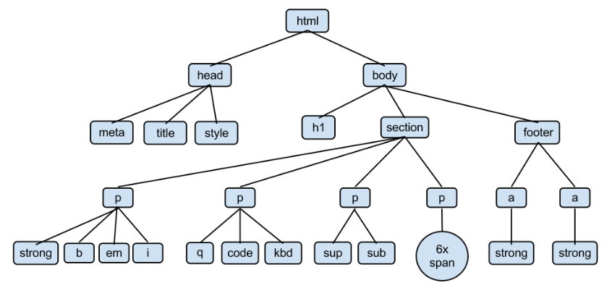
The Structure of a Web Page
https://www.w3schools.com/html/default.asp

Slide 20
Steps for Web Scraping
Download the web page
Parse the page
Locate and download the text information we need
Save the text collected

Slide 21
Libraries
import urllib.request
pip install beautifulsoup4 & from bs4 import BeautifulSoup
pip install scrapy import scrapy
pip install selenium from selenium import webdriver
pip install pyspider from pyspider.libs.base_handler import *

Slide 22
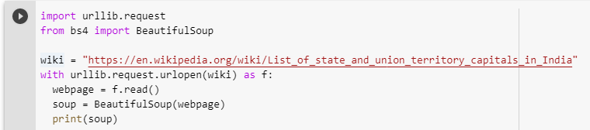
urllib.request+BeautifulSoup collects Wikipedia page
The source code of the Wikipedia page
urllib.request in Python3 documentation: https://docs.python.org/3/library/urllib.request.html
Beautiful Soup Documentation: https://www.crummy.com/software/BeautifulSoup/bs4/doc/
Notes:
wiki = "https://en.wikipedia.org/wiki/List_of_state_and_union_territory_capitals_in_India"

Slide 23
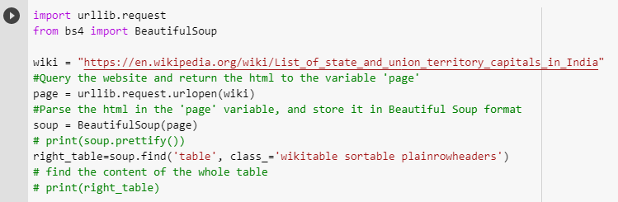
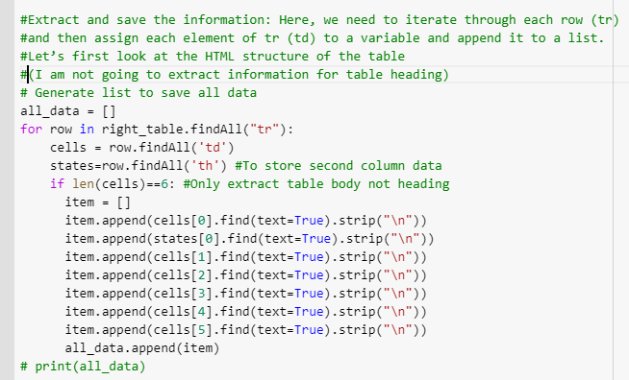
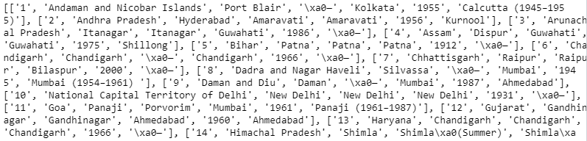
urllib.request+BeautifulSoup

Slide 24
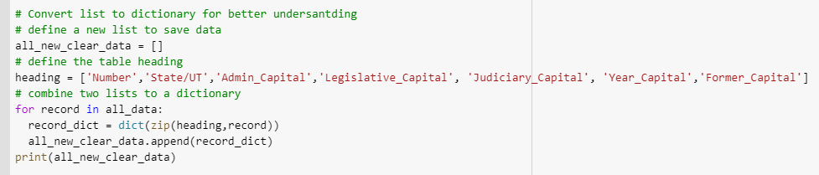
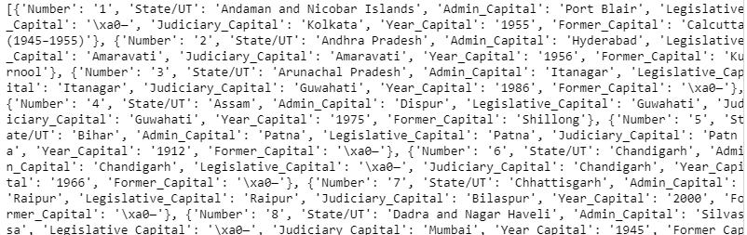
urllib.request+BeautifulSoup

Slide 25
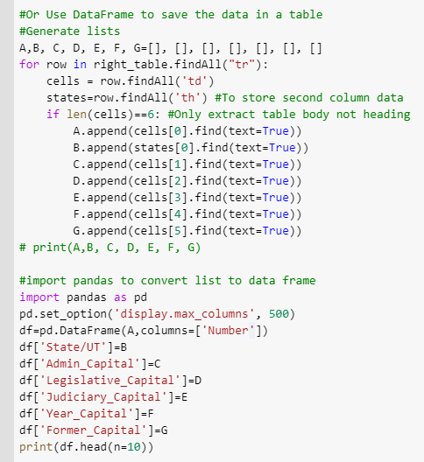
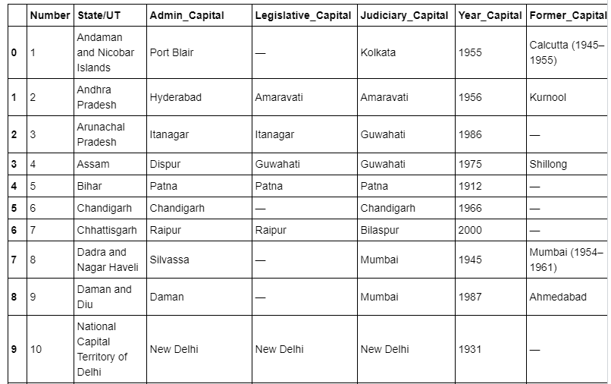
urllib.request+BeautifulSoup

Slide 26
Scrapy collects Amazon reviews – Why the need for scraping Amazon reviews?
Sentiment Analysis over the product reviews
Optimizing drop shipping sales
Web scraping for online reputation monitoring
Notes:
https://blog.datahut.co/scraping-amazon-reviews-python-scrapy/

Slide 27
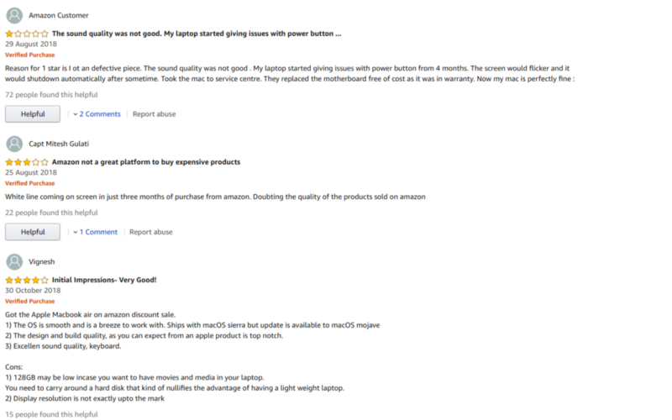
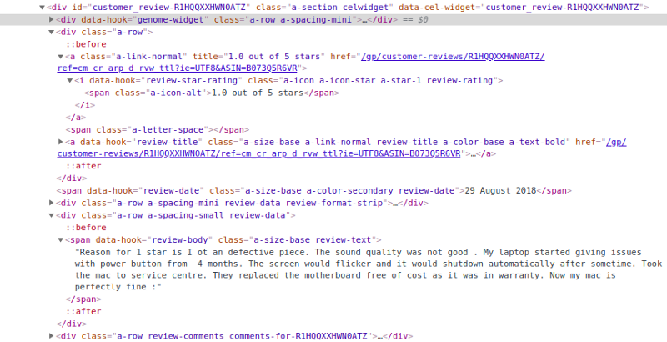
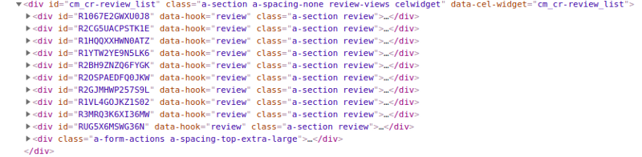
Scrapy collects Amazon reviews
HTML code snippet for Amazon review
Amazon review web page
Detailed HTML code snippet of reviews
Notes:
https://blog.datahut.co/scraping-amazon-reviews-python-scrapy/

Slide 28
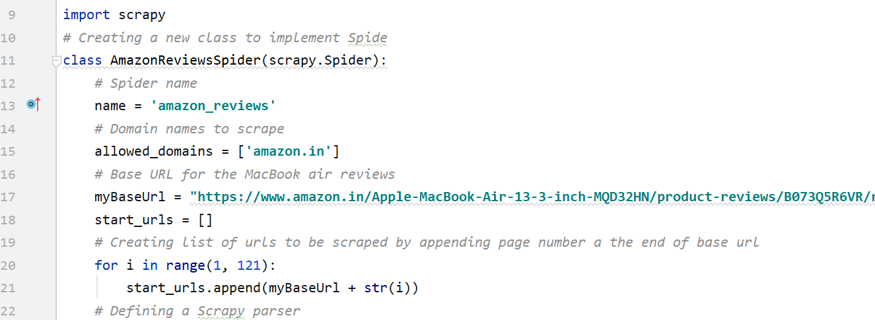
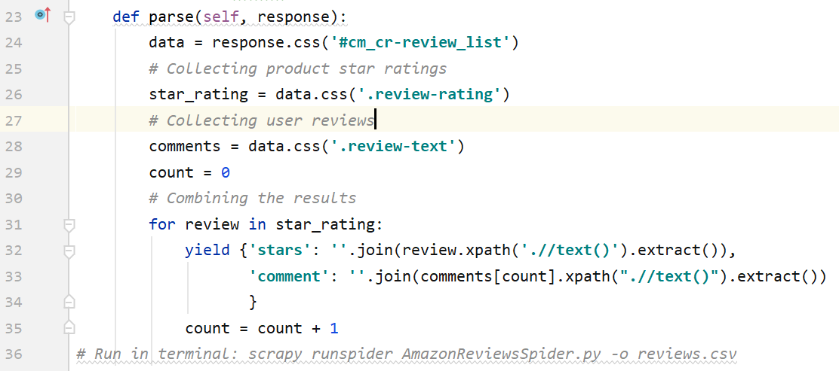
Scrapy collects Amazon reviews
Notes:
https://blog.datahut.co/scraping-amazon-reviews-python-scrapy/

Slide 29
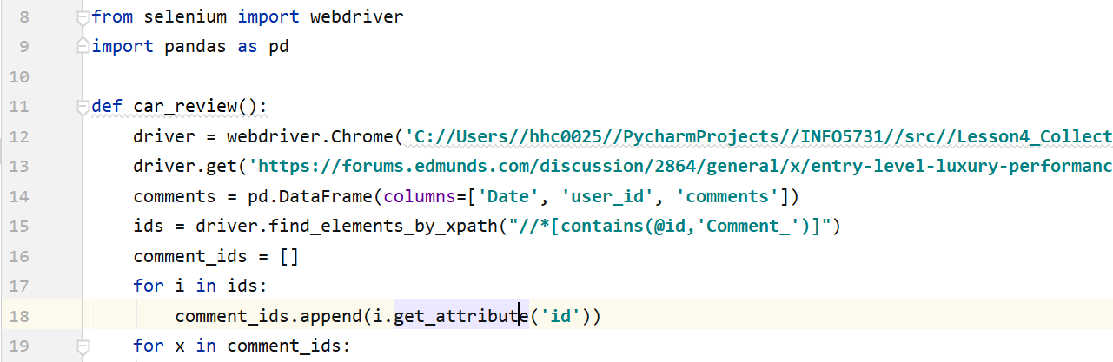
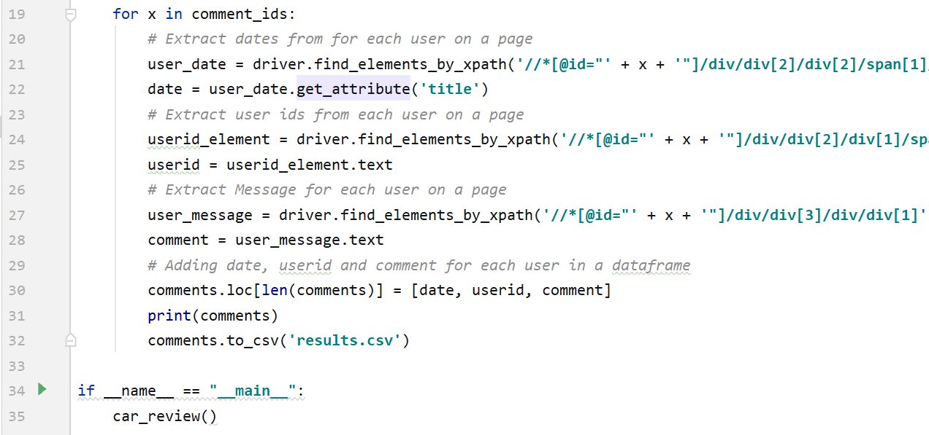
Selenium collects forum review
Notes:
https://forums.edmunds.com/discussion/2864/general/x/entry-level-luxury-performance-sedans/

Slide 30
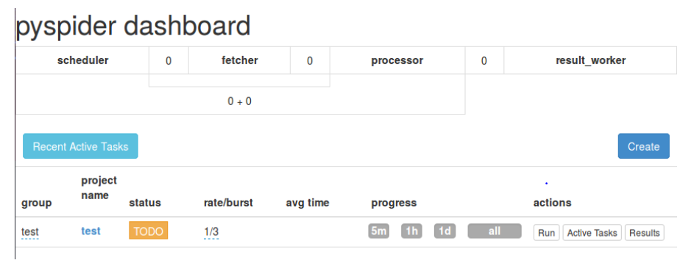
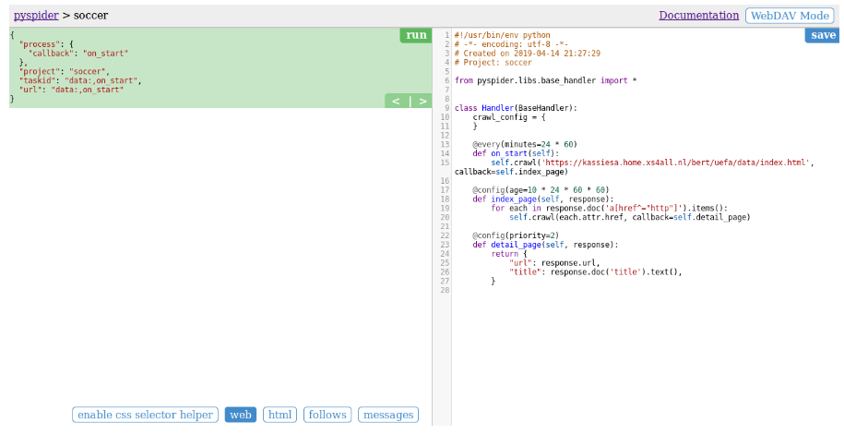
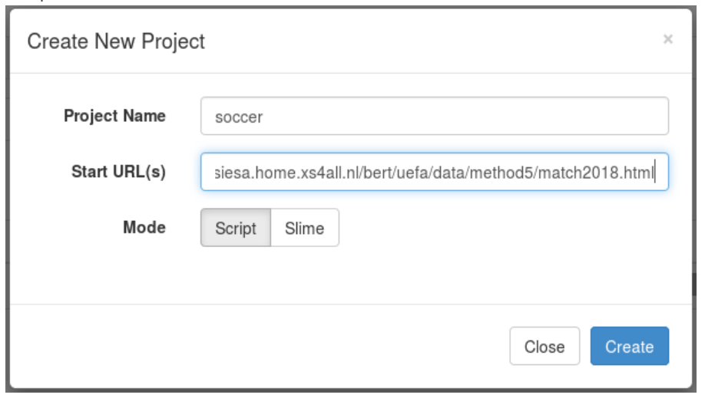
Pyspider collects text data- steps
pip install pyspider
python -m pyspider.run
http://localhost:5000/
Notes:
http://sampig.github.io/tutorial/2019/04/14/learning-python-web-scraping-pyspider
https://kassiesa.net/uefa/data/

Slide 31
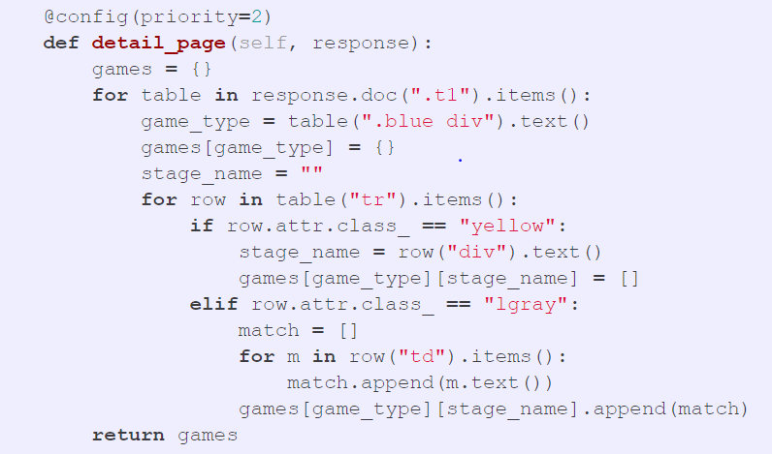
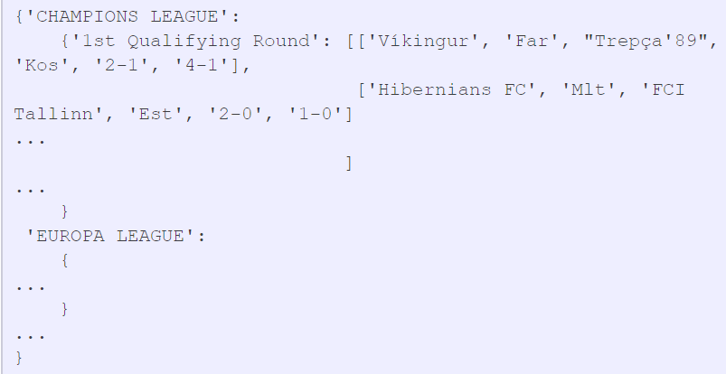
Pyspider collects text data- results
Notes:
http://sampig.github.io/tutorial/2019/04/14/learning-python-web-scraping-pyspider
https://kassiesa.net/uefa/data/

Slide 32
Collecting data from Social media (via API) by using Python
APIs are designed to serve as a common concept between different pieces of software that need to share information with each other
Example: https://developer.twitter.com/en/docs/api-reference-index
Many modern APIs require some type of authentication before they can be used
Understand the methods provided in apis helps us to get the data we want
Notes:
http://bigdataanalyticslab.pbworks.com/w/page/143080356/Twitter%20Data%20Collection%20Workshop

Slide 33
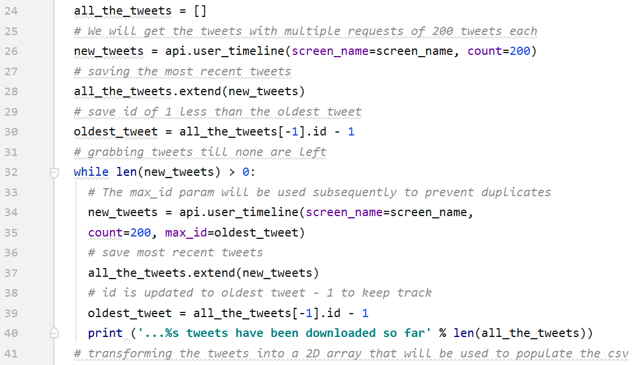
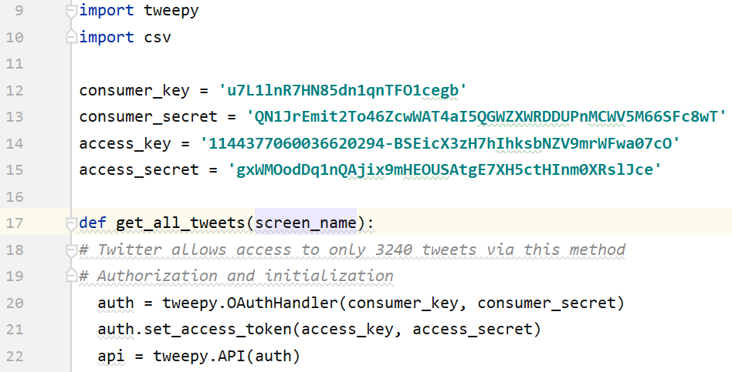
Collecting data from Social media (via API) by using Python
Notes:
https://developer.twitter.com/en/docs/accounts-and-users/follow-search-get-users/api-reference

Slide 34
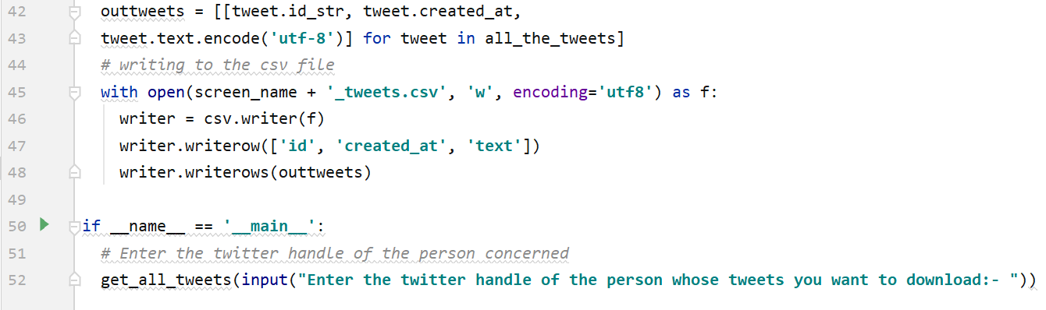
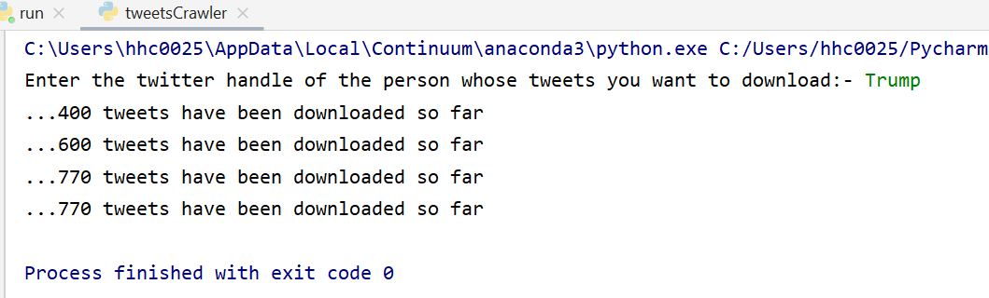
Collecting data from Social media (via API) by using Python
Notes:
https://developer.twitter.com/en/docs/accounts-and-users/follow-search-get-users/api-reference

Slide 35
Summarization of collecting text data using python
Packages?
Strategies?
Steps?
Structure?
Save?

Slide 36
Thank you

